Slide 1
Planning a Software Project

Slide 2
Topics to be covered
Introduction to Project Planning
Software Cost Estimation
Cost Estimation Models
Software Size Metrics
Empirical Estimation
Heuristic Estimation
COCOMO
Effort estimation

Slide 3
Software Project
Goal: Build a software system to meet commitments on cost, schedule, quality
Worldwide - many projects fail
one-third are runaways with cost or schedule

Slide 4
Project Failures
Major reasons for project runaways
unclear objectives
bad planning
no project management methodology
new technology
insufficient staff
All of these relate to project management
Effective project management is key to successfully executing a project

Slide 5
Introduction
Many software projects fail:
due to faulty project management practices:
It is important to learn different aspects of software project management.

Slide 6
Introduction
Goal of software project management:
enable a group of engineers to work efficiently towards successful completion of a software project.

Slide 7
Responsibility of project managers
Project proposal writing,
Project cost estimation,
Scheduling,
Project staffing,
Project monitoring and control,
Software configuration management,
Risk management,
Managerial report writing and presentations, etc.

Slide 8
Introduction
A project manager’s activities are varied.
can be broadly classified into:
project planning,
project monitoring and control activities.
closure

Slide 9
Project Planning
Once a project is found to be feasible,
project managers undertake project planning.

Slide 10
Project Planning Activities
Estimation:
Effort, cost, resource, and project duration
Project scheduling
Staff organization:
staffing plans
Risk handling:
identification, analysis, and abatement procedures
Miscellaneous plans:
quality assurance plan, configuration management plan, etc.

Slide 11
Sliding Window Planning
Involves project planning over several stages:
protects managers from making big commitments too early.
More information becomes available as project progresses.
Facilitates accurate planning

Slide 12
SPMP Document
After planning is complete:
Document the plans:
in a Software Project Management Plan(SPMP) document.

Slide 13
Organization of SPMP Document
Introduction (Objectives,Major Functions,Performance Issues,Management and Technical Constraints)
Project Estimates (Historical Data,Estimation Techniques,Effort, Cost, and Project Duration Estimates)
Project Resources Plan (People,Hardware and Software,Special Resources)
Schedules (Work Breakdown Structure,Task Network, Gantt Chart Representation,PERT Chart Representation)
Risk Management Plan (Risk Analysis,Risk Identification,Risk Estimation, Abatement Procedures)
Project Tracking and Control Plan
Miscellaneous Plans(Process Tailoring,Quality Assurance)

Slide 14
Why improve PM?
Better predictability leading to commitments that can be met
Lower cost through reduced rework, better resource mgmt, better planning,..
Improved quality through proper quality planning and control
Better control through change control, CM, monitoring etc.

Slide 15
The Project Mgmt Process
Has three phases - planning, monitoring and control, and closure
Planning is done before the much of the engineering process (life cycle, LC) and closure after the process
Monitoring phase is in parallel with LC
We focus on planning; monitoring covered through its planning

Slide 16
Project Planning
Basic objective: To create a plan to meet the commitments of the project, I.e. create a path that, if followed, will lead to a successful project
Planning involves defining the LC process to be followed, estimates, detailed schedule, plan for quality, etc.
Main output - a project management plan and the project schedule

Slide 17
Key Planning Tasks
Estimate effort
Define project milestones and create a schedule
Define quality objectives and a quality plan
Identify risks and make plans to mitigate them
Define measurement plan, project-tracking procedures, training plan, team organization, etc.

Slide 18
Software Cost Estimation
Determine size of the product.
From the size estimate,
determine the effort needed.
From the effort estimate,
determine project duration, and cost.

Slide 19
Software Cost Estimation
Effort Estimation
Cost Estimation
Size Estimation
Staffing Estimation
Duration Estimation
Scheduling

Slide 20
Software Cost Estimation
Three main approaches to estimation:
Empirical
Heuristic
Analytical

Slide 21
Software Cost Estimation Techniques
Empirical techniques:
an educated guess based on past experience.
Heuristic techniques:
assume that the characteristics to be estimated can be expressed in terms of some mathematical expression.
Analytical techniques:
derive the required results starting from certain simple assumptions.

Slide 22
Heuristic Estimation Techniques
Single Variable Model:
Parameter to be Estimated=C1(Estimated Characteristic)d1
Multivariable Model:
Assumes that the parameter to be estimated depends on more than one characteristic.
Parameter to be Estimated=C1(Estimated Characteristic)d1+ C2(Estimated Characteristic)d2+…
Usually more accurate than single variable models.

Slide 23
Top down estimation
First determines the total effort, then effort for components
Simple approach – estimate effort from size and productivity
Get the estimate of the total size of the software
Estimate project productivity using past data and project characteristics
Obtain the overall effort estimate from productivity and size estimates
Effort distribution data from similar project are used to estimate effort for different phases

Slide 24
Top-down Estimation
A better method is to have effort estimate as a function of size using: Effort = a * size ^{b}
E is in person-months, size in KLOC
Incorporates the observation that productivity can dip with increased size
Constants a and b determined through regression analysis of past project data

Slide 25
Bottom-up Estimation
An alternate approach to top-down
Effort for components and phases first estimated, then the total
Can use activity based costing - all activities enumerated and then each activity estimated separately
Can group activities into classes - their effort estimate from past data

Slide 26
An Estimation Procedure
Identify programs in the system and classify them as simple, medium, or complex (S/M/C)
Define the average coding effort for S/M/C
Get the total coding effort.
Use the effort distribution in similar projects to estimate effort for other tasks and total
Refine the estimates based on project specific factors

Slide 27
Software Size Metrics
LOC (Lines of Code):
Simplest and most widely used metric.
Comments and blank lines should not be counted.

Slide 28
Disadvantages of Using LOC
Size can vary with coding style.
Focuses on coding activity alone.
Correlates poorly with quality and efficiency of code.

Slide 29
Disadvantages of Using LOC (cont...)
Measures lexical/textual complexity only.
does not address the issues of structural or logical complexity.
Difficult to estimate LOC from problem description.
So not useful for project planning

Slide 30
Function Point Analysis (FPA)
Function Point Analysis (FPA) technique quantifies the functions contained within software in terms that are meaningful to the software users. FPs consider the number of functions being developed based on the requirements specification.

Slide 31
Function Point Metric
Overcomes some of the shortcomings of the LOC metric
Developed by Allan J. Albrecht in 1979 at IBM
further modified by the International Function Point Users Group (IFPUG).
The functional size of the product is measured in terms of the function point

Slide 32
There are two types of functions −
Data Functions
Transaction Functions
Data Functions
Internal Logical Files
External Interface Files
Transaction Functions
External Inputs
External Outputs
External Inquiries

Slide 33
Function Point Analysis
Count the number of functions of each proposed type.
Compute the Unadjusted Function Points(UFP).
Find Total Degree of Influence(TDI).
Compute Value Adjustment Factor(VAF).
Find the Function Point Count(FPC).

Slide 34
Count the number of functions of each proposed type
Various functions used in an application can be put under five types
#inputs, #Outputs, inquiries, #files, #interfaces
Input:
A set of related inputs is counted as one input.
Output:
A set of related outputs is counted as one output.
Inquiries:
Each user query type is counted.
Files:
Files are logically related data and thus can be data structures or physical files.
Interface:
Data transfer to other systems.

Slide 35
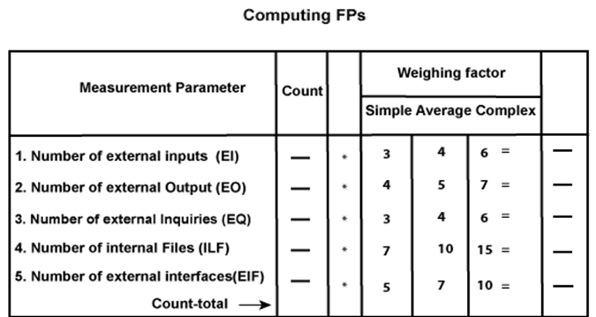
Compute the Unadjusted Function Points(UFP): Weights of 5-FP Attributes
All these parameters are then individually assessed for complexity

Slide 36
Find Total Degree of Influence
Fourteen processing complexity factors are:
4, 1, 0, 3, 3, 5, 4, 4, 3, 3, 2, 2, 4, 5.
TDI=∑(f_{i})]

Slide 37
14 Factors in Function Point Analysis Complexity
1 | Will the application use data communications?
2 | Are data or functions distributed?
3 | Are there specific performance objectives that must be met?
4 | Will the application run on a heavily used configuration requiring special design considerations?
5 | Will the transaction rate of the application be high?
6 | Will there be on-line data entry?
7 | Will the application be designed for end-user efficiency?
8 | Will there be on-line updates?
9 | Is complex processing logic involved?
10 | Is there an intent to provide usability for other applications?
11 | How important are installation ease and conversion?
12 | How important is operational ease?
13 | Will the application be accessed from multiple sites?
14 | Is there an intent with the design to facilitate change?

Slide 38
Compute Value Adjustment Factor(VAF):
VAF = (TDI * 0.01) + 0.65

Slide 39
Find the Function Point Count:
FPC = UFP * VAF

Slide 40
Example: Compute the function point, productivity, documentation, cost per function for the following data
Number of user inputs = 24
Number of user outputs = 46
Number of inquiries = 8
Number of files = 4
Number of external interfaces = 2
Effort = 36.9 p-m
Technical documents = 265 pages
User documents = 122 pages
Average monthly salary of each software developer=$209.86
Various processing complexity factors are: 4, 1, 0, 3, 3, 5, 4, 4, 3, 3, 2, 2, 4, 5.

Slide 41
Solution
Measurement Parameter | Count |  | Weighing factor
1. Number of external inputs (EI) | 24 | * | 4 = 96
2. Number of external outputs (EO) | 46 | * | 4 = 184
3. Number of external inquiries (EQ) | 8 | * | 6 = 48
4. Number of internal files (ILF) | 4 | * | 10 = 40
5. Number of external interfaces (EIF) Count-total → | 2 | * | 5 = 10 378

Slide 42

TDI=sum of all f_{i} (i ← 1 to 14) = 4 + 1 + 0 + 3 + 5 + 4 + 4 + 3 + 3 + 2 + 2 + 4 + 5 = 43
FP = UFP * [0.65 + 0.01 *∑(f_{i})] = 378 * [0.65 + 0.01 * 43] = 378 * [0.65 + 0.43] = 378 * 1.08 = 408

Slide 43

Total pages of documentation = technical document + user document = 265 + 122 = 387pages
Documentation = Pages of documentation/FP = 387/408 = 0.94
Cost = effort x average salary = 36.9 x 209.86= $7744 per Person month

Slide 44
Difference between FP and LOC
FP | LOC
1. FP is specification based. | 1. LOC is an analogy based.
2. FP is language independent. | 2. LOC is language dependent.
3. FP is user-oriented. | 3. LOC is design-oriented.
4. It is extendible to LOC. | 4. It is convertible to FP

Slide 45
Function Point Metric (CONT.)
It is not good for real time systems and embedded systems.
Many cost estimation models like COCOMO uses LOC and hence FPC must be converted to LOC.
Suffers from a major drawback:
the size of a function is considered to be independent of its complexity.
Extend function point metric:
Feature Point metric:
considers an extra parameter:
Algorithm Complexity.

Slide 46
Function Point Metric (CONT.)
Proponents claim:
FP is language independent.
Size can be easily derived from problem description
Opponents claim:
it is subjective --- Different people can come up with different estimates for the same problem.

Slide 47
Effort Estimation
For a project total cost and duration has to be committed in start
Requires effort estimation, often in terms of person-months
Effort estimate is key to planning - schedule, cost, resources depend on it
Many problems in project execution stem from improper estimation

Slide 48
Estimation..
No easy way, no silver bullet
Estimation accuracy can improve with more information about the project
Early estimates are more likely to be inaccurate than later
More uncertainties in the start
With more info, estimation becomes easier

Slide 49
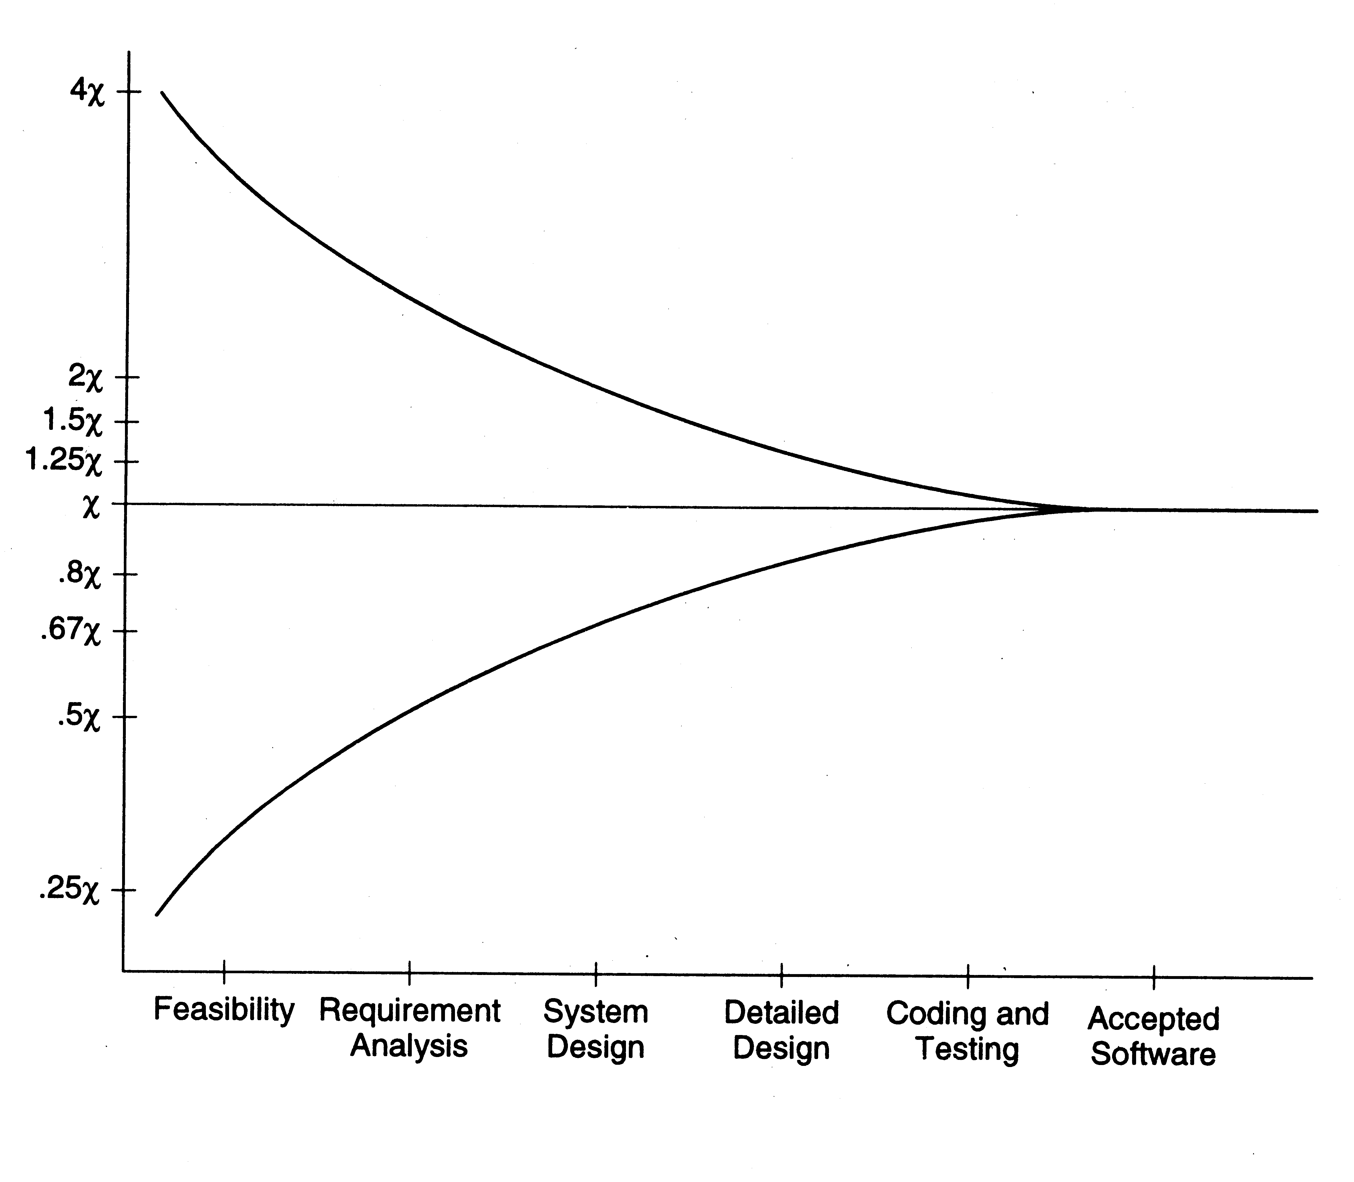
Estimation accuracy

Slide 50
Effort Estimation Models..
A model tries to determine the effort estimate from some parameter values
A model also requires input about the project, and cannot work in vacuum
So to apply a model, we should be able to extract properties about the system
Two types of models - top-down and bottom-up

Slide 51
Effort Estimation Models

Slide 52
COCOMO Model
Cocomo (Constructive Cost Model) is a regression model based on LOC
developed by a software engineer Barry Boehm in 1981.
The COCOMO estimates the cost for software product development in terms of effort (resources required to complete the project work) and schedule (time required to complete the project work) based on the size of the software product.
It estimates the required number of Man-Months (MM) for the full development of software products

Slide 53
COCOMO Model
Uses size, but adjusts using some factors
Basic procedure
Obtain initial estimate using size
Determine a set of 15 multiplying factors from different project attributes
Adjust the effort estimate by scaling it with the final multiplying factor

Slide 54
According to COCOMO, there are three modes of software development projects that depend on complexity
Organic Project
Semidetached Project
Embedded Project

Slide 55
Organic Project
It belongs to small & simple software projects which are handled by a small team with good domain knowledge and few rigid requirements.
Example: Small data processing or Inventory management system.

Slide 56
Semidetached Project
It is an intermediate (in terms of size and complexity) project, where the team having mixed experience (both experience & inexperience resources) to deals with rigid/nonrigid requirements.
Example: Database design or OS development.

Slide 57
Embedded Project
This project having a high level of complexity with a large team size by considering all sets of parameters (software, hardware and operational).
Example: Banking software or Traffic light control software.

Slide 58
Types of COCOMO Model
Depending upon the complexity of the project the COCOMO has three types
The Basic COCOMO
The Intermediate COCOMO
The Detailed COCOMO

Slide 59
The Basic COCOMO
Static model to estimates software development effort quickly and roughly.
It mainly deals with the number of lines of code
the level of estimation accuracy is less as we don’t consider the all parameters belongs to the project.
The estimated effort and scheduled time for the project are given by the relation:
Effort (E) = a*(KLOC)^{b} Man-Months (MM) Scheduled Time (D) = c*(E)^{d} Months(M)
Where,
E = Total effort required for the project in Man-Months (MM).
D = Total time required for project development in Months (M).
KLOC = the size of the code for the project in Kilo lines of code.
a, b, c, d = The constant parameters for a software project.

Slide 60
PROJECT TYPE | a | b | c | d
Organic | 2.4 | 1.05 | 2.5 | 0.38
Semidetached | 3 | 1.12 | 2.5 | 0.35
Embedded | 3.6 | 1.2 | 2.5 | 0.32

Slide 61
Example
For a given project was estimated with a size of 300 KLOC.
Calculate the Effort, Scheduled time for development.
Also, calculate the Average resource size and Productivity of the software for Organic project type.

Slide 62
For Organic: Answer
Effort (E) = a*(KLOC)^{b} = 2.4*(300)^{1.05} = 957.61 MM
Scheduled Time (D) = c*(E)^{d} = 2.5*(957.61)^{0.38} = 33.95 Months(M)
Avg. Resource Size = E/D = 957.61/33.95 = 28.21 Mans
Productivity of Software = KLOC/E = 300/957.61 = 0.3132 KLOC/MM = 313 LOC/MM

Slide 63
For Semidetached: Answer
Effort (E) = a*(KLOC)^{b} = 3.0*(300)^{1.12} = 1784.42 MM
Scheduled Time (D) = c*(E)^{d} = 2.5*(1784.42)^{0.35} = 34.35 Months(M)

Slide 64
For Embedded: Answer
Effort (E) = a*(KLOC)^{b} = 3.6*(300)^{1.2} = 3379.46 MM
Scheduled Time (D) = c*(E)^{d} = 2.5*(3379.46)^{0.32} = 33.66 Months(M)

Slide 65
The Intermediate COCOMO
The intermediate model estimates software development effort in terms of
size of the program and
other related cost drivers parameters (product parameter, hardware parameter, resource parameter, and project parameter) of the project.

Slide 66
The Intermediate COCOMO
The estimated effort and scheduled time are given by the relationship:
Effort (E) = a*(KLOC)^{b} *EAF MM Scheduled Time (D) = c*(E)^{d} Months(M)
Where,
E = Total effort required for the project in Man-Months (MM).
D = Total time required for project development in Months (M).
KLOC = The size of the code for the project in Kilo lines of code.
a, b, c, d = The constant parameters for the software project.
EAF = It is an Effort Adjustment Factor, which is calculated by multiplying the parameter values of different cost driver parameters. For ideal, the value is 1.

Slide 67
Product Parameter
COST DRIVERS PARAMETERS | VERY LOW | LOW | NOMINAL | HIGH | VERY HIGH
Required Software | 0.75 | 0.88 | 1 | 1.15 | 1.4
Size of Project Database | NA | 0.94 |  | 1.08 | 1.16
Complexity of The Project | 0.7 | 0.85 |  | 1.15 | 1.3

Slide 68
Hardware Parameter
COST DRIVERS PARAMETERS | VERY LOW | LOW | NOMINAL | HIGH | VERY HIGH
Performance Restriction | NA | NA | 1 | 1.11 | 1.3
Memory Restriction | NA | NA |  | 1.06 | 1.21
virtual Machine Environment | NA | 0.87 |  | 1.15 | 1.3
Required Turnabout Time | NA | 0.94 |  | 1.07 | 1.15

Slide 69
Personnel Parameter
COST DRIVERS PARAMETERS | VERY LOW | LOW | NOMINAL | HIGH | VERY HIGH
Analysis Capability | 1.46 | 1.19 | 1 | 0.86 | 0.71
Application Experience | 1.29 | 1.13 |  | 0.91 | 0.82
Software Engineer Capability | 1.42 | 1.17 |  | 0.86 | 0.7
Virtual Machine Experience | 1.21 | 1.1 |  | 0.9 | NA
Programming Experience | 1.14 | 1.07 |  | 0.95 | NA

Slide 70
Project Parameter
COST DRIVERS PARAMETERS | VERY LOW | LOW | NOMINAL | HIGH | VERY HIGH
Software Engineering Methods | 1.24 | 1.1 | 1 | 0.91 | 0.82
Use of Software Tools | 1.24 | 1.1 |  | 0.91 | 0.83
Development Time | 1.23 | 1.08 |  | 1.04 | 1.1

Slide 71
Example
For a given project was estimated with a size of 300 KLOC.
Calculate the Effort, Scheduled time for development by considering developer having high application experience and very low experience in programming.

Slide 72
Ans:
Given the estimated size of the project is: 300 KLOC
Developer having highly application experience: 0.82 (as per above table)
Developer having very low experience in programming: 1.14(as per above table)
EAF = 0.82*1.14 = 0.9348 Effort (E) = a*(KLOC)^{b} *EAF = 3.0*(300)^{1.12} *0.9348 = 1668.07 MM Scheduled Time (D) = c*(E)^{d} = 2.5*(1668.07)^{0.35} = 33.55 Months(M)

Slide 73
The Detailed COCOMO
It is the advanced model that estimates the software development effort like Intermediate COCOMO in each stage of the software development life cycle process.

Slide 74
Advantages and Disadvantages of COCOMO Model
Advantages
Easy to estimate the total cost of the project.
Easy to implement with various factors.
Provide ideas about historical projects.
Disadvantages
It ignores requirements, customer skills, and hardware issues.
It limits the accuracy of the software costs.
It mostly depends on time factors.

Slide 75
Shortcoming of basic and intermediate COCOMO models
Both models:
consider a software product as a single homogeneous entity.
However, most large systems are made up of several smaller sub-systems.
Some sub-systems may be considered as organic type, some may be considered embedded, etc.
for some the reliability requirements may be high, and so on.

Slide 76
Complete COCOMO
Cost of each sub-system is estimated separately.
Costs of the sub-systems are added to obtain total cost.
Reduces the margin of error in the final estimate.

